Slide 1

Principles of Cyber-physical systems
L1
Francesco Bellotti
Slides from:
http://www.seas.upenn.edu/~cis540/
Prof. Rajeev Alur

Slide 2
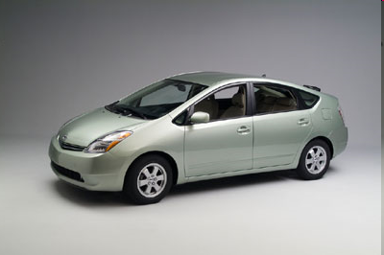
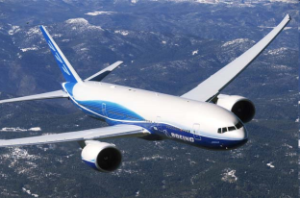
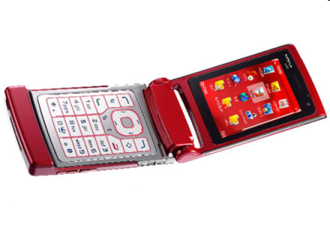
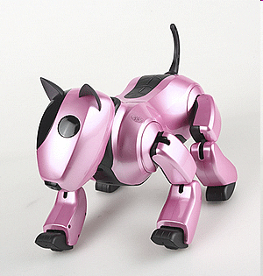
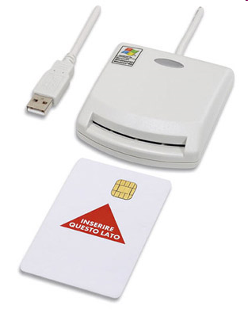
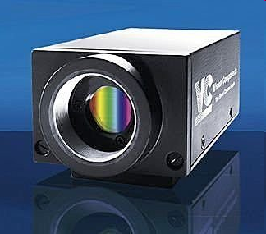
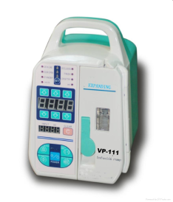
Embedded Systems Everywhere!
Hw & sw inside
CIS 540 Spring 2015; Lecture Jan 14

Slide 3
From Desktops to Cyber-Physical Systems
Traditional computers: Stand-alone device running software applications (e.g. data processing)
Traditional controllers: Devices interacting with physical world via sensors and actuators (e.g. thermostat)
Embedded Systems
Special-purpose system with integrated microcontroller/software
Cameras, watches, washing machines…
CIS 540 Spring 2015; Lecture Jan 14

Slide 4
Cyber-Physical Systems
Control
Monitor and influence
physical world
Computation
Process information
to make decisions
Electronics
Communication
Exchange data
to collaborate
CIS 540 Spring 2015; Lecture Jan 14

Slide 5
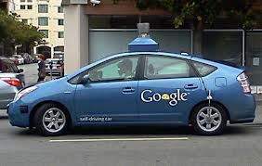
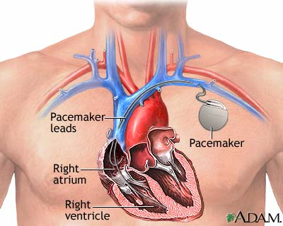
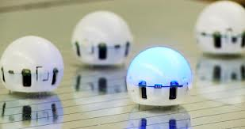
Cyber-Physical Systems
Driverless Cars
Medical devices
Coordinating robots
CIS 540 Spring 2015; Lecture Jan 14

Slide 6
Design of Cyber-Physical Systems
Systems that integrate control, computation, and communication can do
Cool things,
And useful things…
Lots of promise and potential: medicine, transportation, energy, …
So what’s the challenge?
CIS 540 Spring 2015; Lecture Jan 14

Slide 7
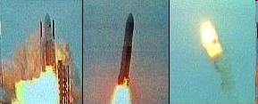
Ariane 5 Explosion
“It took the European Space Agency 10 years and $7 billion to produce Ariane 5. All it took to explode that rocket less than a minute into its maiden voyage last June, scattering fiery rubble across the mangrove swamps of French Guiana, was a small computer program trying to stuff a 64-bit number into a 16-bit space”
A bug and a crash, J. Gleick, New York Times, Dec 1996
CIS 540 Spring 2015; Lecture Jan 14

Slide 8
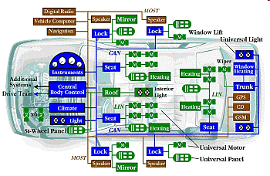
Prius Brake Problems Blamed on Software Glitches
“Toyota officials described the problem as a "disconnect" in the vehicle's complex anti-lock brake system (ABS) that causes less than a one-second lag. With the delay, a vehicle going 60 mph will have traveled nearly another 90 feet before the brakes begin to take hold”
CNN Feb 4, 2010
CIS 540 Spring 2015; Lecture Jan 14
Notes:
27 metri. 1 piede, 30 cm

Slide 9
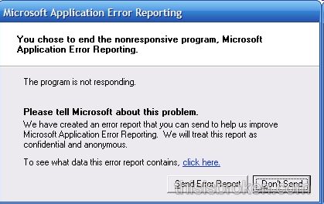
Software: The Achilles’ Heel
Software everywhere means bugs everywhere
2002 study by NIST:
Software bugs cost US economy $60 billion annually (0.6% of GDP)
Lack of trust in software as technology barrier
Would you use an autonomous software-controlled round-the-clock monitoring and drug-delivery device?
Grand challenge:
Technology for designing reliable cyber-physical systems
CIS 540 Spring 2015; Lecture Jan 14
Notes:
Nat.l Institute of Standards and Technology

Slide 10
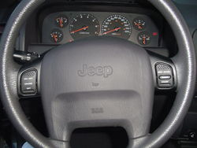
Let’s Design a Cruise Controller
What’s the goal of a cruise controller?
Automatically adjust the speed of the car so that it matches the speed desired by the driver
CIS 540 Spring 2015; Lecture Jan 14

Slide 11
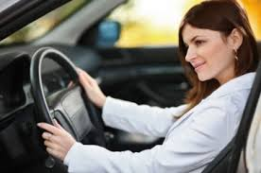
Block Diagrams of High-Level Design
CruiseController
How does this system interact with the rest of the world ?
CIS 540 Spring 2015; Lecture Jan 14

Slide 12
Interfaces for Components: Inputs and Outputs
cruise
CruiseController
pause
Driver
inc/dec
Driver interacts with the system using 4 buttons:
Cruise button to turn the cruise on or off
Pause button to suspend/restart its operation
Inc and Dec buttons to increment or decrement desired speed
CIS 540 Spring 2015; Lecture Jan 14

Slide 13
Interfaces for Components: Inputs and Outputs
cruise
speed
pause
Tachometer
CruiseController
Driver
inc/dec
What other information does the cruise-controller need ?
And who supplies it?
CIS 540 Spring 2015; Lecture Jan 14

Slide 14
Interfaces for Components: Inputs and Outputs
cruise
speed
pause
Tachometer
CruiseController
Driver
inc/dec
What should be the outputs of the cruisecontroller?
And who needs these outputs?
CIS 540 Spring 2015; Lecture Jan 14

Slide 15
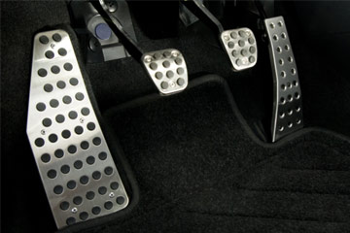
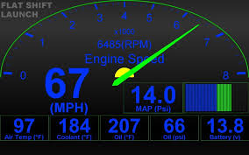
Throttle
Force
cruise
speed
pause
Tachometer
CruiseController
Driver
inc/dec
DesiredSpeed
speed
Display
CIS 540 Spring 2015; Lecture Jan 14

Slide 16
Compositional Design
Force
cruise
speed
pause
CruiseController
inc/dec
DesiredSpeed
speed
How to break up the computation of the cruise controller into subtasks?
CIS 540 Spring 2015; Lecture Jan 14

Slide 17
Decomposing the Cruise Controller
Force
ControlSpeed
DesiredSpeed
speed
cruise
speed
SetSpeed
pause
inc/dec
DesiredSpeed
speed
CIS 540 Spring 2015; Lecture Jan 14

Slide 18
Designing SetSpeed Component
cruise
speed
SetSpeed
pause
inc/dec
DesiredSpeed
Goal: Compute the desired cruising speed in response to
the commands from the driver
CIS 540 Spring 2015; Lecture Jan 14

Slide 19
Designing SetSpeed: State Machines
pause, inc, dec
inc: r := r+1
cruise: r := speed
OFF
ON
dec: r := r-1
cruise
pause
cruise
pause
PAUSED
DesiredSpeed corresponds to the variable r
inc, dec
CIS 540 Spring 2015; Lecture Jan 14
Notes:
r: state var.
pause, inc, dec: input

Slide 20
Designing ControlSpeed Component
speed
ControlSpeed
DesiredSpeed
Force
Goal: Determine the force to be applied to throttle so that speed becomes equal to DesiredSpeed
CIS 540 Spring 2015; Lecture Jan 14

Slide 21
Capturing Requirements
speed
ControlSpeed
DesiredSpeed
Force
Requirements: Mathematically precise description of what a system is supposed to do.
Writing requirements is key to ensuring reliability of systems
Requirement 1: Actual speed eventually converges to desired speed
Requirement 2: Speed of the car stays “stable”
CIS 540 Spring 2015; Lecture Jan 14

Slide 22
A bit of Physics: Modeling a car
Velocity v
Force F
Weight mg
Friction k v
Angle θ
Newton’s law of motion gives
F – kv – mg sin θ = m a
CIS 540 Spring 2015; Lecture Jan 14

Slide 23
ControlSpeed Component
ControlSpeed
F = K_{P} ( r - v)
DesiredSpeed r
Force F
Velocity v
F – kv – mg sin θ = m a
Angle θ of the road with horizontal (disturbance)
Car
Control Theory: Mathematical techniques to compute force (F) as a function of velocity (v) and desired speed (r)
CIS 540 Spring 2015; Lecture Jan 14

Slide 24
Does our controller work ?
ControlSpeed
F = K_{P} ( v – r)
r
Force F
Velocity v
F – kv – mg sin θ = m a
θ
Car
Verification Tools: Allow you to check if system model indeed works as expected, that is, satisfies requirements
CIS 540 Spring 2015; Lecture Jan 14
Notes:
Implemented control, proportional to the error

Slide 25
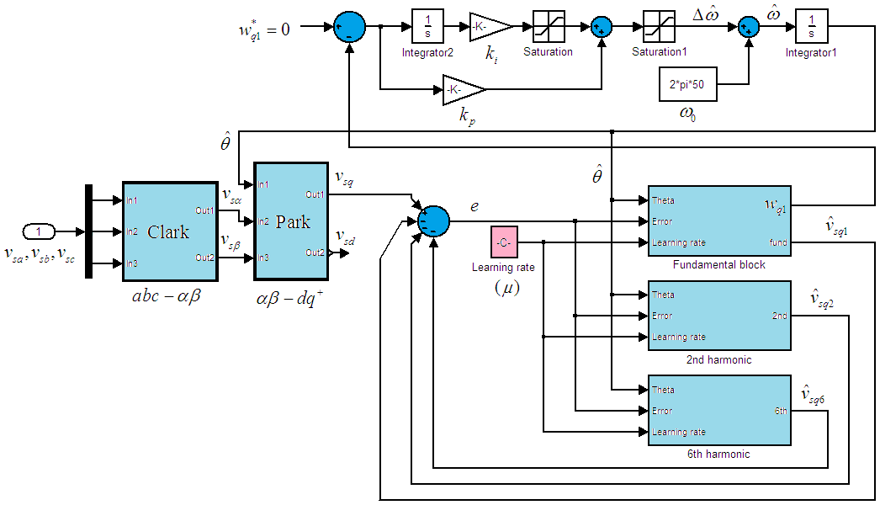
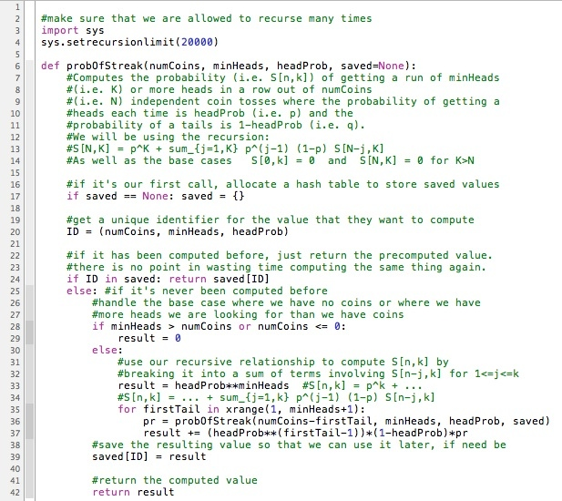
Model-based design != Coding
Design using high-level block diagrams and state machines gets automatically compiled into low-level code !
Models not only of system being designed, but also of its environment
CIS 540 Spring 2015; Lecture Jan 14

Slide 26
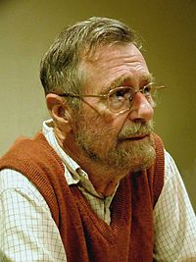
Verification != Simulation/Testing
Model/Program
Verifier
yes/proof
Requirement
no/bug
Program testing can be used to show the presence
of bugs, but never their absence!
Edsger W. Dijkstra
CIS 540 Spring 2015; Lecture Jan 14

Slide 27
Formal Verification
Model/Program
Verifier
yes/proof
Requirement
no/bug
Goal: Establish that model satisfies requirements under all possible scenarios
First challenge: Need formal definitions of “model” and “requirement” to make the problem mathematically precise
Second challenge: Need verification techniques and tools
CIS 540 Spring 2015; Lecture Jan 14

Slide 28
Course Topics
Goal: Introduction to principles of design, specification, analysis and implementation of CPS
Disciplines
Model-based design
Concurrency theory
Distributed algorithms
Formal specification
Verification techniques and tools
Emphasis on mathematical concepts
CIS 540 Spring 2015; Lecture Jan 14
Notes:
Control theory
Real-time systems
Hybrid systems

Slide 29
Theme 1: Formal Models
Mathematical abstractions to describe system designs
Modeling formalisms
Synchronous models (Chapter 2)
Asynchronous models (Chapter 4)
Continuous-time dynamical systems (Chapter 6)
Timed models (Chapter 7)
Hybrid systems (Chapter 9)
Modeling concepts
Syntax vs semantics
Composition
Input/output interfaces
Nondeterminism, fairness, …
CIS 540 Spring 2015; Lecture Jan 14
Notes:
Continuous-time dynamical systems (Chapter 6)
Hybrid systems (Chapter 9)

Slide 30
Theme 2: Specification and Analysis
Formal techniques to ensure correctness at design time
Requirements
Safety (invariants, monitors)
Liveness (temporal logic, automata over infinite sequences)
Analysis techniques
Deductive: Inductive invariants
Enumerative and symbolic search for state-space exploration
Model checking
(Linear-algebra-based analysis of dynamical systems)
Verification of timed systems
CIS 540 Spring 2015; Lecture Jan 14
Notes:
Stability
Schedulability

Slide 31
Theme 3: Model-based Design
Design and analysis of illustrative computing problems
Design methodology
Structured modeling (bottom-up, top-down)
Requirements-based design and design-space exploration
Case studies
Distributed coordination: mutual exclusion, consensus, leader election
Communication: Reliable transmission, synchronization
Control design: PID, cruise controller
CPS: obstacle avoidance for robots, smart intersection
CIS 540 Spring 2015; Lecture Jan 14
Notes:
CPS: Pacemaker, obstacle avoidance for robots, multi-hop control network

Slide 32
Model-Based Design
Block Diagrams
Widely used in industrial design
Tools: Simulink, Modelica, LabView, RationalRose…
Key question: what is the execution semantics?
What is a base component
How do we compose components to form complex components?
CIS 540 Spring 2015; Lecture Jan 14

Slide 33
Course Logistics
Course participation
Ask questions! Answer questions!
Use of laptops, mobile phones etc during class is not allowed
Textbook: Principles of Cyber-Physical Systems
Complementary courses and course material
Introduction to embedded systems; Lee/Seshia,UC Berkeley
Foundations of cyber-physical systems; Platzer, CMU
Modeling/analysis software
NuXMV model checker
SPIN model checker
UPPAAL model checker
MATLAB, Stateflow/Simulink by Mathworks
Theory course
Emphasis on Abstract thinking + Rigorous reasoning
Lots of applications
franz@elios.unige.it; francesco.bellotti@unige.it
CIS 540 Spring 2015; Lecture Jan 14

Slide 34
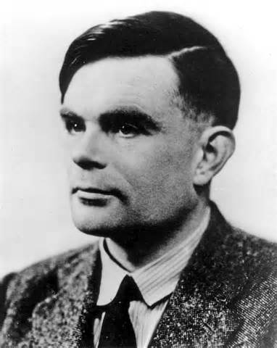
Functional vs Reactive Computation
Classical model of computation: Functional
Given inputs, a program produces outputs
Desired functionality described by a mathematical function
Example: Sorting of names, Shortest paths in a weighted graph
Theory of computation provides foundation for this
Canonical model: Turing machines
Reactive
System interacts with its environment via inputs and outputs in an ongoing manner
Desired behaviors: which sequences of observed input/output interactions are acceptable?
Example: Cruise controller in a car
CIS 540 Spring 2015; Lecture Jan 14

Slide 35
Sequential vs Concurrent Computation
Classical model of computation: Sequential
A computation is a sequence of instructions executed one at a time
Well understood and canonical model: Turing machines
Concurrent Computation
Multiple components/processes exchanging information and evolving concurrently
Logical vs physical concurrency
Broad range of formal models for concurrent computation
Key distinction: Synchronous vs Asynchronous
CIS 540 Spring 2015; Lecture Jan 14

